Slide 1
Designing Advanced Energy-Efficient Wireless Access Networks by a Capacity Based Deployment Tool
Future Network & Mobile Summit 2013
July 5, 2013 margot.deruyck@intec.ugent.be
ir. Margot Deruyck
Prof. dr. ir. Wout Joseph
Dr. ir. Emmeric Tanghe
Prof. dr. ir. Luc Martens
Ghent University/iMinds
Department of Information Technology – Wireless & Cable
Notes:
1

Slide 2
Overview
Context & objective
Methodology
Case Study
Conclusion
Notes:
2

Slide 3
Context & objective (1)
Extreme growth of mobile users the past few years
  From 20% in 2003 to 67% in 2009
Within ICT
  9% is consumed by radio access networks
Within radio access network
  90% consumed by base stations
  10% consumed by user devices
  → Focus on base stations to reduce power consumption in wireless access networks!!!

Slide 4
Context & objective (2)
Objective
  Deployment tool for the design and optimisation of future energy-efficient wireless access networks
    Key technique: sleep modes
      Network responds to the actual bit rate demands of users
  Applied on a realistic case in Ghent, Belgium
    Investigating three main functionalities added to LTE-Advanced
      Carrier aggregation
      Heterogeneous network
      Extended support for MIMO

Slide 5
Overview
Context & objective
Methodology
Case study
Conclusion
Notes:
5

Slide 6
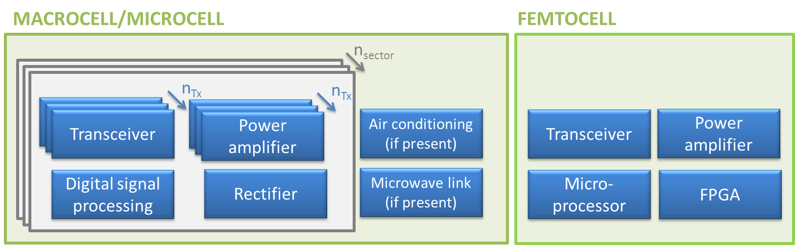
Power consumption model
 | Macrocel
Transceiver | 100 W
Power amplifier | 156.3 W
Digital signal proc. | 100 W
Rectifier | 100 W
Air conditioning | 225 W
Backhaul | 80 W
TOTAL | 1673.9 W
 | Femtocel
Transceiver | 1.7 W
Power amplifier | 2.4 W
Microprocessor | 3.2 W
FPGA | 4.7 W
TOTAL | 12 W

Slide 7
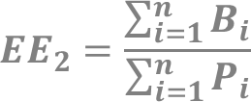
Methodology
Energy efficiency metric:
  with
    A = the area covered by the network (in km²)
    P_{i} = the power consumption of base station i (in W)
    B_{i} = the bit rate offered by base station i (in Mbps)
The higher EE, the more energy-efficient
 | [Mbps/W]

Slide 8
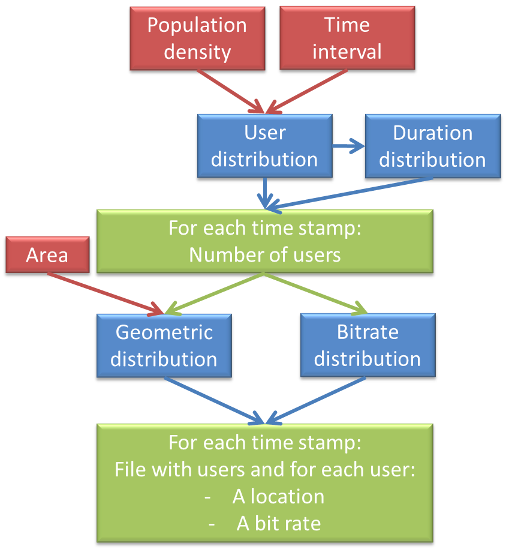
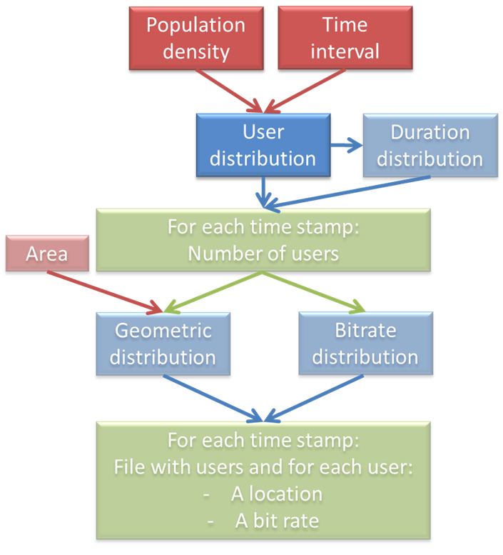
Deployment tool (2)
Phase 1: generating traffic
User distribution
  Poisson distribution with arrival rate λ(t)
    λ(t) = sinusoidal curve scaled based on the population density
      Integrated over the time interval
Duration distribution
  Lognormal distribution
    μ = 1.69s
    s= 1.0041
Geometric distribution
  Users are uniformly distributed over the considered area
Bit rate distribution
  20%: 2 Mbps (mobile PC)
  5%: 1 Mbps (tablet)
  50%: 250 kbps (smartphone)
  25%: 0.64 kbps (voice only user)

Slide 9
Deployment tool (5)
Part II: traffic-based network design
Try to connect user with active BS
  Lowest path loss
    And lower than maximum allowable path loss
  Can the required capacity be offered
Otherwise, activate a sleeping BS
  Same requirements as above
  When activated: can other already connected users be transferred?
Otherwise, user can not be covered

Slide 10
Overview
Context & objective
Methodology
Case study
Conclusion
Notes:
10

Slide 11
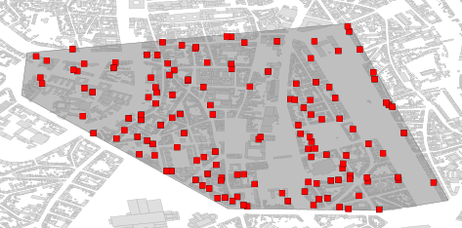
Case study (1)
Reference scenario
  LTE-Advanced
  Suburban area
    1.54 km²
    Ghent, Belgium
  139 macrocell base stations
  SISO
  No carrier aggregation

Slide 12
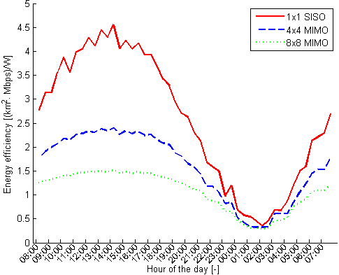
Results (1)
MIMO
For the considered case
  MIMO does not improve EE
    Same coverage
    Power consumption MIMO higher than SISO
      Lower no. BS but not low enough

Slide 13
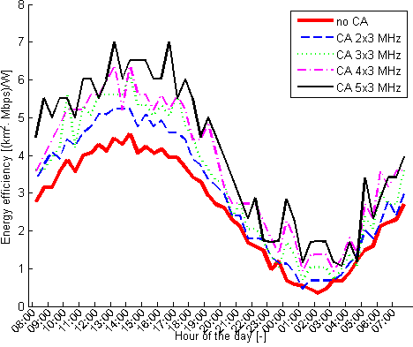
Results (2)
Carrier aggregation
Higher no. of aggregated carriers
= higher EE
  Higher bit rate available
  More users served by 1 BS
  Less BSs needed
Highest efficiency
  Aggregating 5 carriers
  Power consumption reduced by 13.9% on average

Slide 14
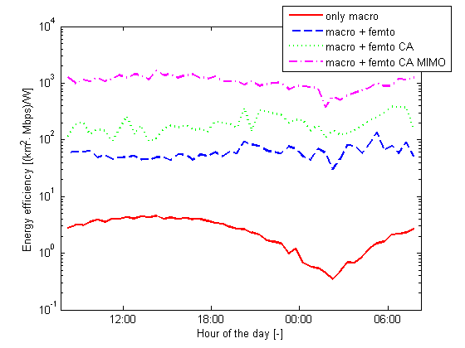
Results (3)
Heterogeneous deployments
Lowest efficiency
  Only macrocells
    Higher power consumption
Highest efficiency
  Femtocell with MIMO and CA
    MIMO increases range
    CA increases bit rate
    Low power consumption
  Power consumption reduced by 99.3% on average
    Compared to only macrocells
    88.0% reduction for femtocells without MIMO and CA
  For this case
    Further research necessary to confirm results!

Slide 15
Conclusion
A capacity-based deployment tool for energy-efficient wireless access network is presented
  Minimal power consumption
  Responding to the actual bit rate demand of the user
  Key technique: introduction of sleep mode
Tool applied on a realistic case in Ghent, Belgium for LTE-Advanced
  Average power consumption reduction of 13.9% obtained when aggregating 5 carriers compared to no carrier aggregation
  Average power consumption reduction of 99.3% obtained when using femtocells with CA and 8x8 MIMO compared to network with only SISO macrocell base stations
Future networks should use LTE-Advanced
  Single use case: Further investigation is still needed to confirm results!

Slide 16

Questions?

